Slide 1
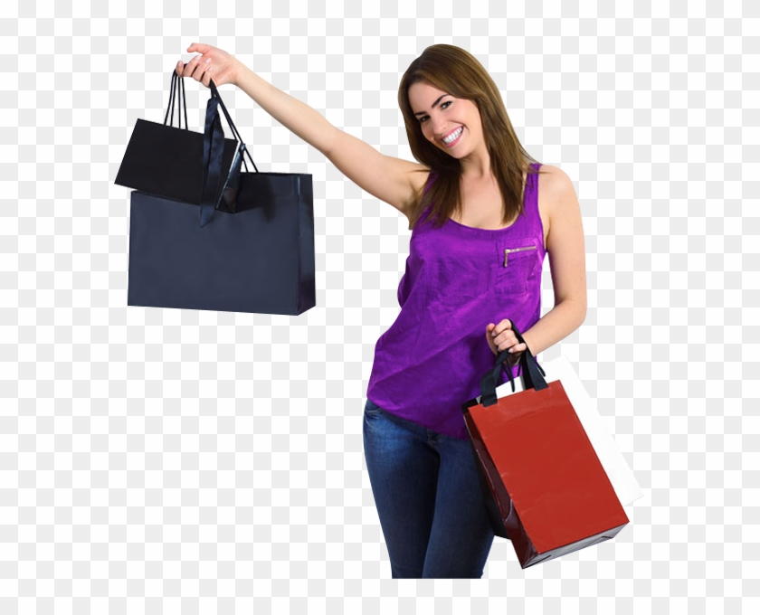
Case Study: Amazon Fashion Discovery Engine(Content Based Recommendation)
Group-2
Member1: Nazmus Shadat Shohan
Member2: Tasfia Zaman Raisa
Member3: Mujahidul Islam
Member4: Sazzad Hossain
Member5: Roksana Yeasmin
Member6: Masudur Rahman

Slide 2
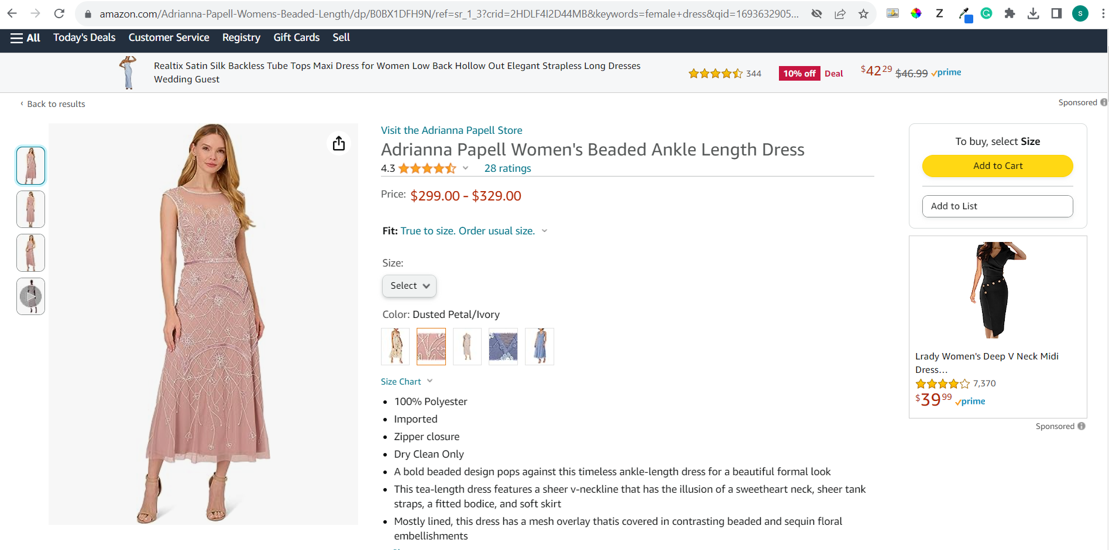

Slide 3
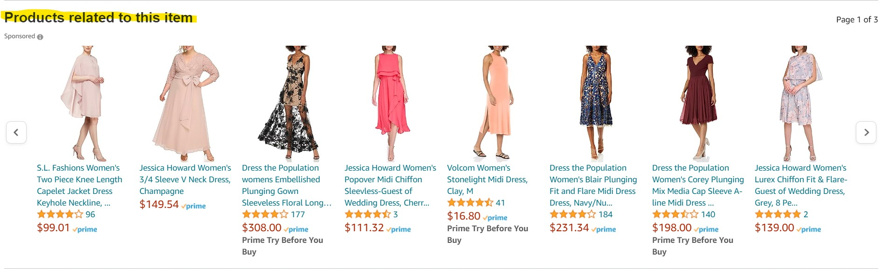
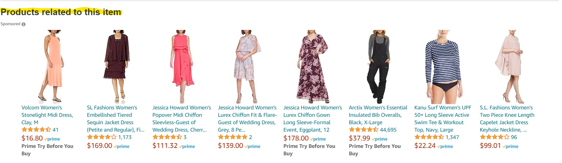

Slide 4
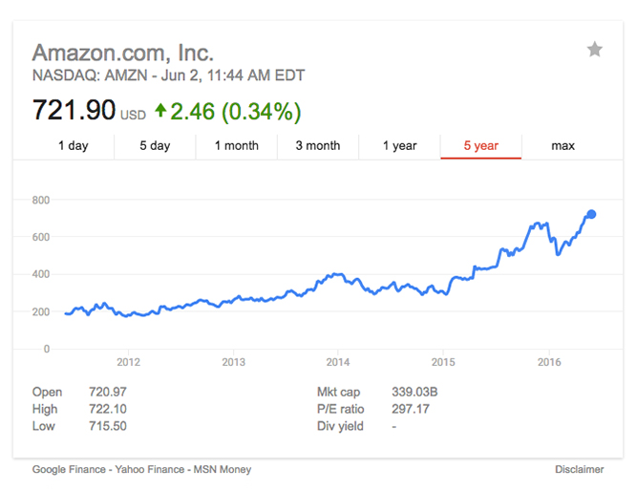
Amazon Sales over the years
In 2015, they generated 107.1 billion in net revenue.
They have billions of data points to test so many different things to find out what works and what doesn’t, quickly. Over the years we’ve been watching the way Amazon does recommendations both on-site and off, via email. Plus we also found out that their recommendations via email convert better than their on-site recommendations

Slide 5
35% of Amazon.com’s revenue is generated by its recommendation engine.
So what’s their strategy?

Slide 6
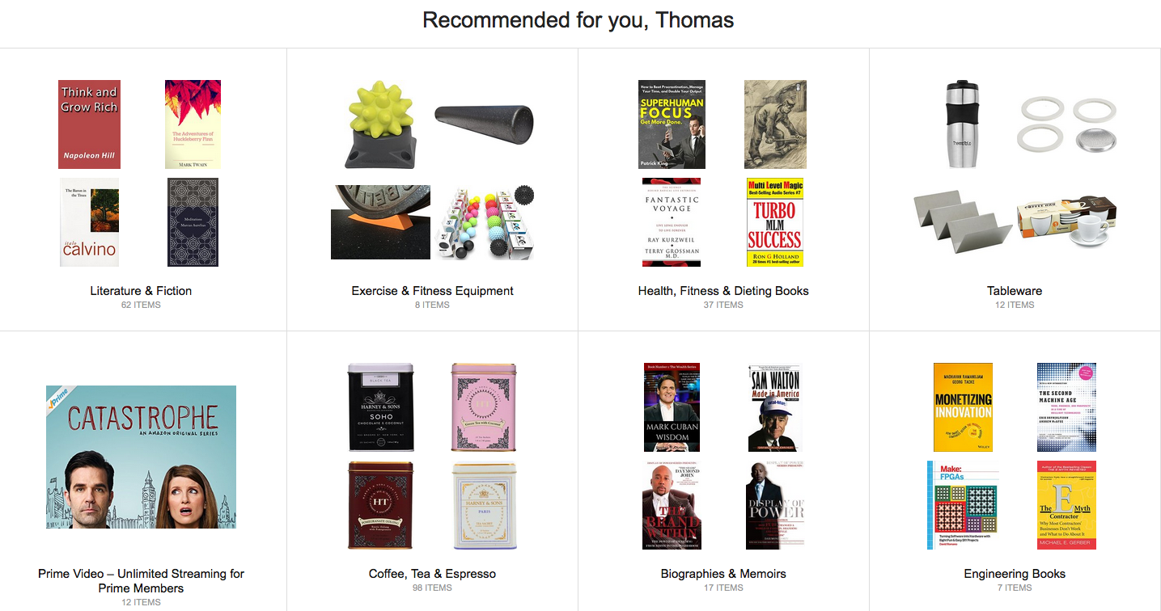
Onsite Recommendation(recommend for you)
Clicking on the “Your Recommendations” link on Amazon.com leads users to a page full of products recommended just for you. Amazon recommends a range of products from different categories you’ve been browsing, with the aim of putting products in front of you that you’re likely to click, learn more about and buy.

Slide 7
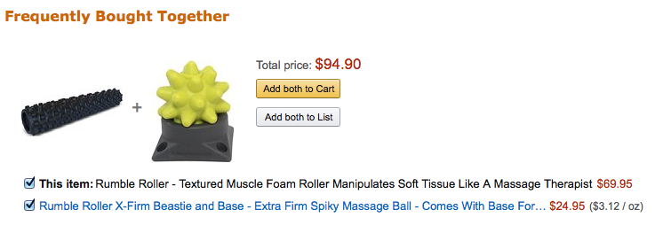
Onsite Recommendation(frequently bought together)
This recommendation has one main goal: increase average order value. ‘Frequently bought together’ recommendations aim to up-sell and cross-sell customers by providing product suggestions based on the items in their shopping cart or below products they’re currently looking at on-site.

Slide 8
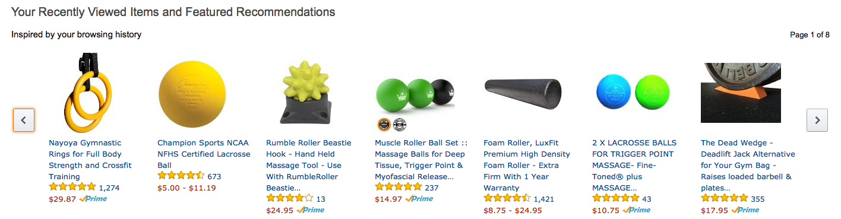
Onsite Recommendation(Recenlty Viewed Items)
Here Amazon looks at products you’ve been browsing and recommends very similar products of different shapes, sizes and brands to help you find something very similar to a product you’ve already shown an interest in. They throw different brands, colours, shapes and sizes at you with the hope that they’ll place one product in front of you that you cannot resist

Slide 9
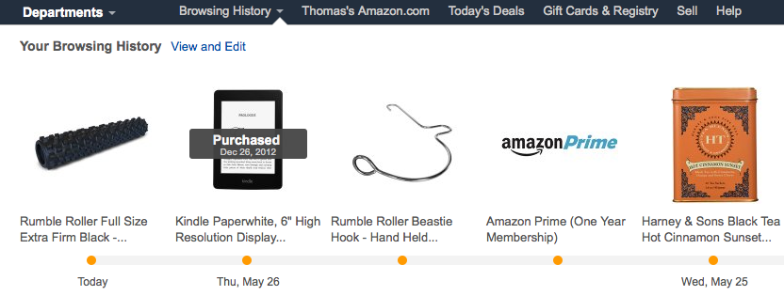
Onsite Recommendation(Browsing History)
If you’ve already looked at a product, it means you were slightly interested and Amazon knows it, so they’ll show you your browsing history in case you want to quickly go back and buy something you previously showed an interest in.

Slide 10
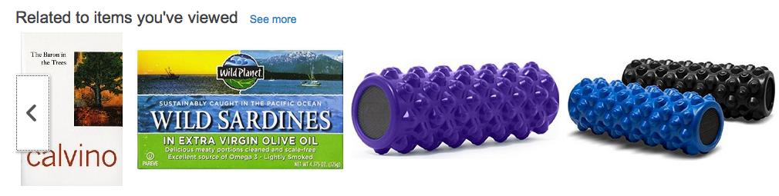
Onsite Recommendation(related to viewed items)
Just as it says, Related to items you’ve viewed displays similar products in different sizes, brands, etc., to products you’ve looked at in the past. This has the same goal as point #3 (to help you find a product you have to buy), but Amazon has labelled it differently on their site.

Slide 11
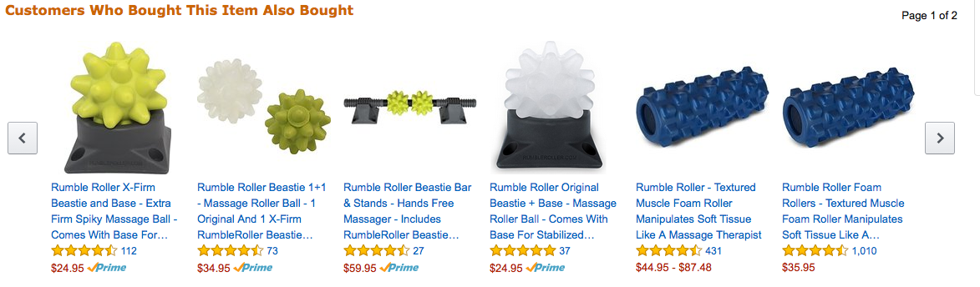
Onsite Recommendation(Association Rule)
Similar to #2 (frequently bought together), Amazon displays items that have been purchased together in the past, with the goal to increase average order value through up-sells and cross sells. My guess is that these items are purchased together a little less often than ‘frequently bought together’ and is a way for Amazon to sell items that are not as popular to help retailers move their inventory.

Slide 12
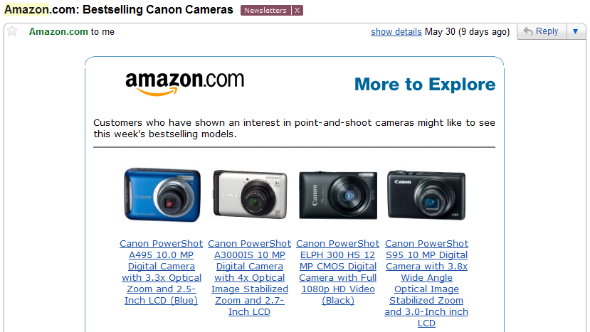
Offline Recommendation(Best Selling Models )
The first email was a range of best selling models from a product category they visited. As only Canon models were showcased in this email, you can be sure they were browsing that brand of Camera on-site or even added a Canon camera to their shopping cart.

Slide 13
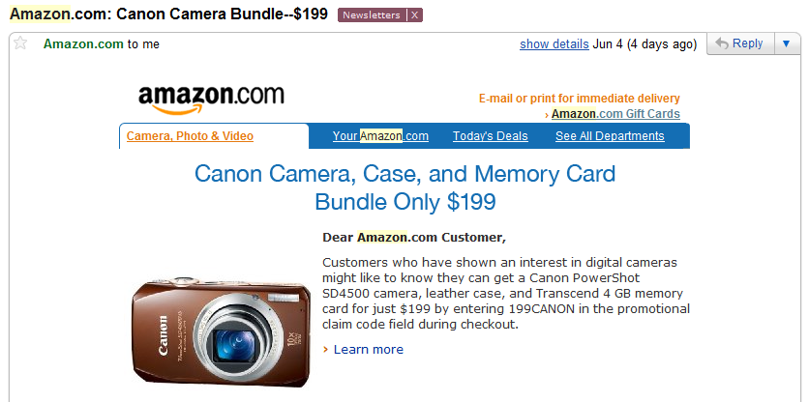
Offline Recommendation(Best Selling Models )
This recommendation email contained items frequently purchased together, with the aim to get you to buy a camera and cross-sell its accessories in order to increase average order value and the amount of revenue they generate from each customer.

Slide 14
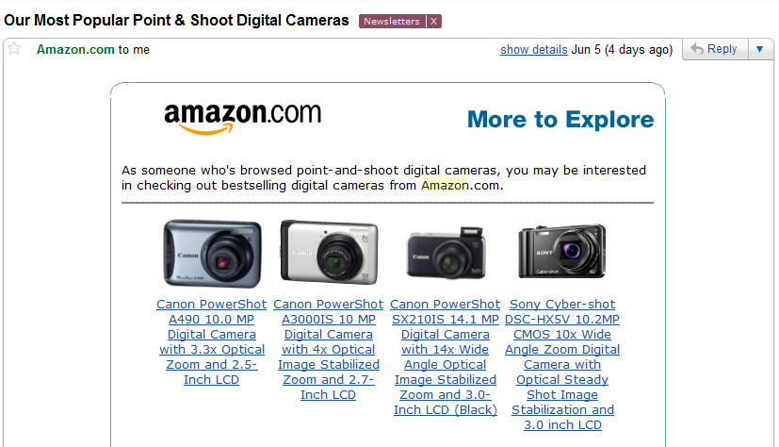
BEST SELLERS ACROSS THE ENTIRE PRODUCT CATEGORY
This email contains top selling items from across the entire product category (digital cameras) the user was browsing. There is no focus on any specific brand, again they just display best sellers that most people end up buying. These items have the best reviews and conversions rates and will likely turn an interested browser into a customer.

Slide 15
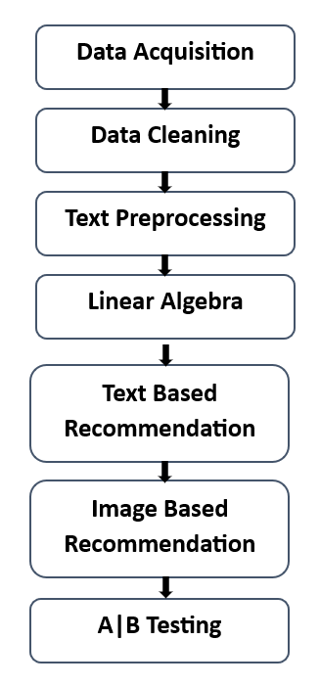
WorkFlow

Slide 16
Data Acquisition(Amazon Product Advertising)
I actually used Amazon’s own product advertising API as we need to obtain data from amazon.com using any programming language of our choice in a policy-compliant manner.
I obtained data on women’s tops and shirts and got data of roughly about 183000 products. We got data like Image-URL, Title, Price, Product Description, etc. So we will primarily focus on the data of women’s tops.

Slide 17
Data Acquisition(Overview of the data)
Dataset is a set of data points.
A row here represents a product in this dataset which is also known as data point.
Each column represents a variable/feature of a given product. For ex: It can have aprice, title, imageURL etc.

Slide 18
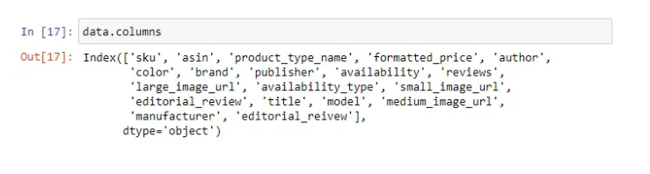
Data Acquisition(Overview of the data)
Number of data points/products: 183138
Number of features/variables: 19

Slide 19
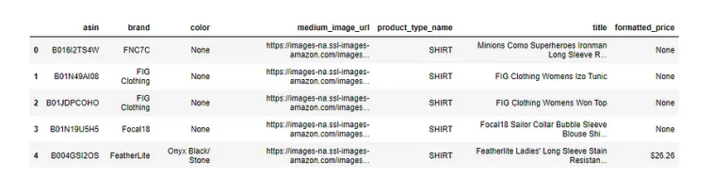
Data Acquisition(Overview of the data)
I will be using only 6 features out of these 19 features in this workshop.
— 1. asin (Amazon standard identification number)- A unique no given to each
product at amazon.com.
— 2. Brand (brand to which the product belongs to)
— 3. color (color information of apparel, it can contain many colors as a value , for
ex: black and blue stripes)
— 4. product_type_name (type of the apparel, ex: SHIRT/TSHIRT )
— 5. medium_image_url (URL of the image)
— 6. title (title of the product)
— 7. formatted_price (price of the product)

Slide 20
Overview of the data and terminology
I will be using only 6 features out of these 19 features in this workshop.
— 1. asin (Amazon standard identification number)- A unique no given to each
product at amazon.com.
— 2. Brand (brand to which the product belongs to)
— 3. color (color information of apparel, it can contain many colors as a value , for
ex: black and blue stripes)
— 4. product_type_name (type of the apparel, ex: SHIRT/TSHIRT )
— 5. medium_image_url (URL of the image)
— 6. title (title of the product)
— 7. formatted_price (price of the product)

Slide 21
Data Cleaning & Understanding
This is extremely important step in machine learning which is often overlooked. The better we understand our data, the more better models we can build. If we don’t want our models to suffer, let’s focus.

Slide 22
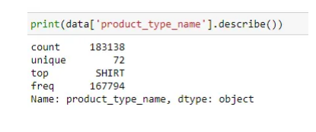
1. Basic stats for feature: product_type_name
Here we can notice that, there are certain cells where data is missing or it is none. So let’s understand our data.
Out of 183138 products, 72 products are unique.
Top most product type found is “SHIRT”, which is present in 167794 out of 183138 that is roughly 91%.
The 10 most frequent product_type_names:

Slide 23
2. Basic stats for feature: brand
As in the data, out of 183138 products, brand name is given only for 182987 products. So there are 151 missing values.
There are 10577 unique brands.
The top most brand is “Zago” and is present in 223 rows.
The top 10 brands are:

Slide 24
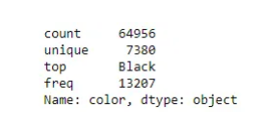
3. Basic stats for feature: color
64956 products out of 183138 products have color information. That’s approximately 35.4%.
There are 7380 unique colors.
The top most color is black and is found in 13207 products, which is 7.28% of the products.
For 118182 products, color is not specified at all.

Slide 25
4. Basic stats for feature: formatted_price
Only 28395 products out of 183K have information about price, which is roughly about 15.5%.
There are 3135 unique price points.
The top most price point is $19.99 and is present for 945 products.
So, price value is missing for lot of the products and other look sensible.

Slide 26
5. Basic stats for feature: title
Titles are short and very informative.
They are one of the most important feature and we will use it extensively.
They are mostly present for every product, which makes it the best feature

Slide 27
Benefit of Data cleaning
So, instead of operating on 183K data points, I will be operating on a subset of data points by removing those rows where some data is empty. As operating on 183K dataset is quite computationally expensive and time taking, so we will operate on a subsetof it.

Slide 28
Remove rows where formatted price is null
I removed those rows in the dataset, where formatted_price was null or where price information was not given. I used logical not operation here to find all the formatted_price fields which are not null and stored them in data.
data=data.loc[~data['formatted_price'].isnull()] print('Number of data points After eliminating price=NULL :’ , data.shape[0])
Number of data points After eliminating price=NULL : 28395

Slide 29
Remove rows where color is null
In the similar way, I removed those rows in the dataset, where color was null or any information about color of the product was not given. I used logical not operation here to find all the color fields which are not null and stored them in data.
data =data.loc[~data['color'].isnull()] print('Number of data points After eliminating color=NULL :’ , data.shape[0])
Number of data points After eliminating color=NULL : 28385
We brought down the number of data points from 183K to 28K. Those who have time and no computational problem.

Slide 30
How would we deal with too many NULL values where imputations is hard and the column like price is too important to be dropped ?
In such case we will take all the rows without price=null as train data. The rows where price=null is considered as test data. So, we train the model using train data and predict the price for test data as it’s price was null. Now instead of imputation we can replace the null values with the predicted values. There is a another easy way which says fill all the null values with “0”.

Slide 31
Remove Duplicate Items/Products
Remove duplicates : part 1
We have about 28K product at this time.
We need to find the number of products that have duplicate titles or exactly same title. As we know title is one of the most important feature and it is short and informative.
So 2325 products out 28K products have duplicate titles.
Here we can observe these products/Shirts are exactly same in color except different in size maybe(S,M,L,XL). Let’s say, the first image is the query product and we have to find similar products. If we recommend these exact shirts as query product of just different size to the customer , then it leads to bad customer experience because titles are exactly same.
So to avoid bad customer experience, we will remove duplicates.
We can even have example of duplication where products are exactly same but different in color. When one of these images is the query product, it’s not always best to recommend different color product of the same product.
So, in our data there are many duplicate products like the above examples, we need to de-dupe them for better results.

Slide 32
Remove Duplicate: Part 2
I will remove all products with very few words in title. So if the length of the title is greater than 5, then I will consider it, otherwise I will remove it.

Slide 33
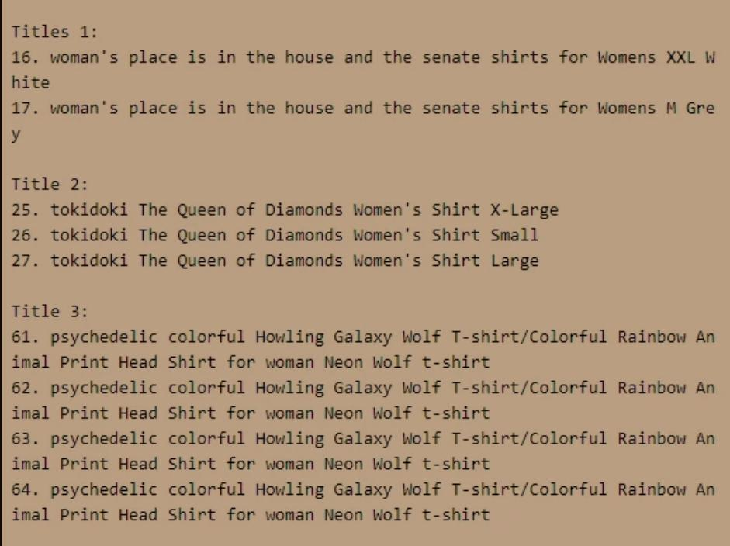
Remove Duplicate: Part 2
Now, I will sort the whole data based on title (alphabetical order of title) in the descending order.
Some examples of duplicate titles that differ only in the last few words/suffix.

Slide 34
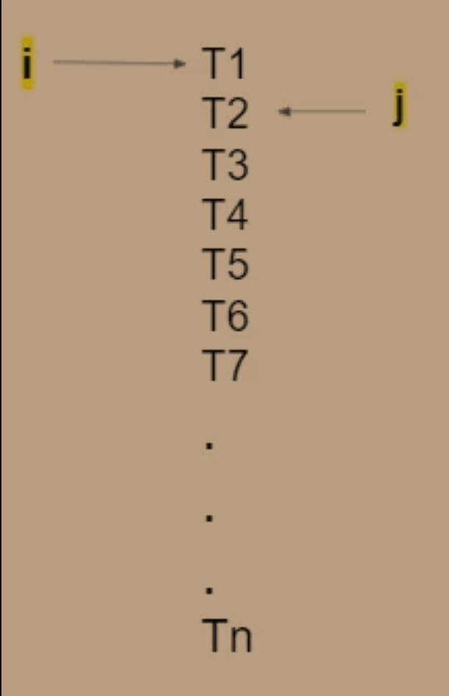
Remove Duplicate: Part 2
As these titles are sorted alphabetically, we can get these similar titles with just different last few words consecutively. So we will this logic. Let’s say I have my variable “i” here and my variable “j” here at (i+1). Since they are already sorted, I will compare how many words does my ith title and jth title differ in. The way I can do this is, I can pull all the words of T1 in a set and all the words of T2 in a set and carry out set difference between them. If the difference is less than 2, then we will consider those two titles as similar and remove the duplicate which differ only at the end. So we will remove T2 and then increment “j” and keep doing it. Once we compare T1 with everything else. Then again I will increment my “i” to T3 and “j” to (i+1) place. We will keep doing this till the end of for loops.

Slide 35
Remove Duplicate: Part 3
there are some products whose titles are not adjacent but very similar.

Slide 36
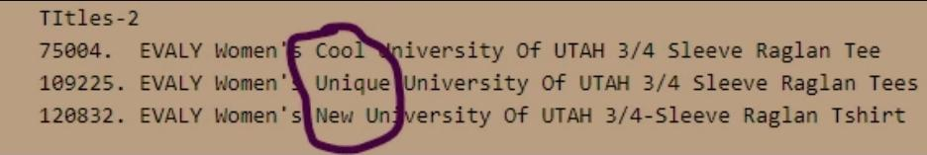
Rrmove Duplicate: Part 3
These titles are exactly same except that one word that differs and cannot be solved sorting it alphabetically.

Slide 37
Remove Duplicate: Part 3
i: 1 → n
j: 1 → n
For every pair of (i,j): we will find out how many words they differ in.
If difference of words in (Title i, Title j) is ≤ K words (let’s say), then we will remove Title j.

Slide 38
Remove Duplicate: Part 3
Number of Pair Comparison
As we know, n = 17K products now, so how many pairs can I form now ?
→ nC2 =n(n-1)/2
→17KC2= 17592(17592–1)/2 = 154730436 = 154 Million
So, we need to carry out 154 Million title pairs compairision.

Slide 39
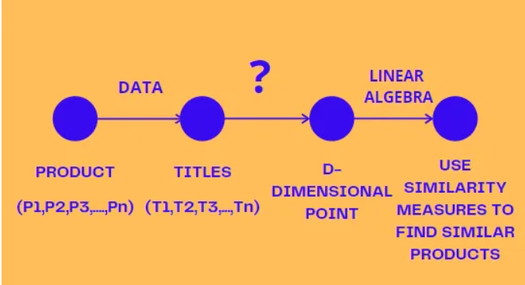
Text Based Product Similarity
For every product, we have a title.
Given a title, How can we convert it into a d-dimensional point ?
There are multiple ways to convert a text into d-dimensional point.
Given a d-dimensional representation of title,we can use similarity measures to find similar products..

Slide 40
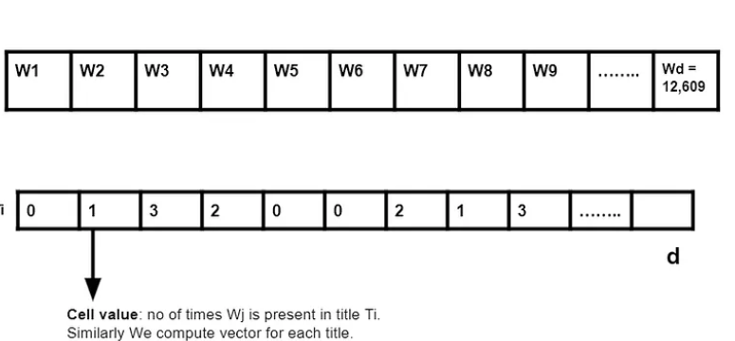
Bag of Words(Product Similarity Measurement)
1.S = Set of words which are present in any of the titles (T1,T2,T3,….,Tn).
Let’s say this set S has size “d”, or d is size of unique words in S.
d = no of unique words in S.
2.Now , I will be creating a d-dimensional vector for each title. Let’s say word1 in vocabulary/set is present 0 times in title 1, so we put value as “0” in the vector. Similarly word 4 is present 2 times in title 1, so we put the value as “2” in the vector.

Slide 41
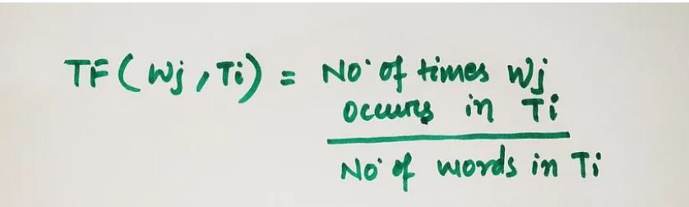
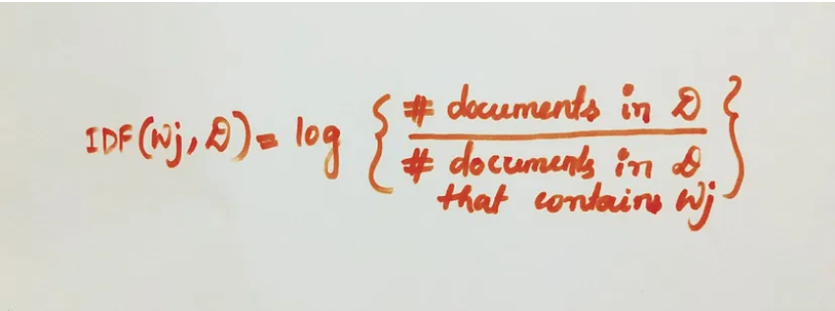
TF-IDF: featurizing text based on word-importance
TF-IDF: featurizing text based on word-importance.TF-IDF is used to quantitatively assess the importance of words within individual titles (documents) in a corpus. It combines Term Frequency (TF) to measure word frequency within a title and Inverse Document Frequency (IDF) to measure word rarity across the entire corpus. TF-IDF assigns higher values to words that are frequent in a title but rare in the corpus, emphasizing their significance.

Slide 42
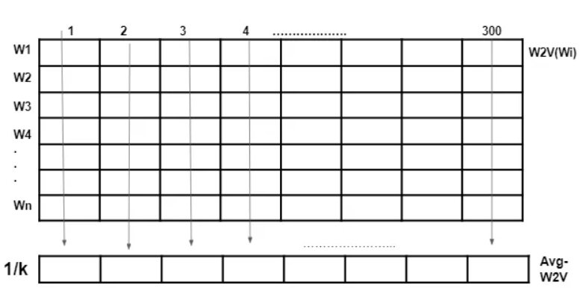
Text Semantics based product similarity: Word2Vec
Let’s assume there are k words in our title Ti. To get word2vec of Ti, we take sum of all the first components of all words, similarly keep adding components of all cells till 300 dimension and get a new vector. I will then divide all the components of the new vector by k. This is known as average word2Vec of any sentence..

Slide 43
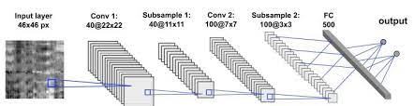
Image Based product similarity: ConvNets
We can extract various features from the image like edges, shapes, colors, pattern like zebra stripe, leopard print etc. What if given an image and we can construct a vector. A part of the vector would be about color, a part of the vector would be about shapes and a part of the vector would be about pattern or edges. Now I can use euclidean distance to find distance between two vectors.
So, given an image, I will use convolutional neural networks like VGG-16 to convert my image into dense vector. If two images are very similar, then euclidean distance between vector 1 of image 1 and vector 2 of image 2 will be very small.

Slide 44
Image Based product similarity: ConvNets(Continue)
We will use some existing CNN’s which is VGG-16 for our task to build image based product similarity.VGG-16 takes an image and converts it into a 25,088 dimensional dense vector.
We will use some existing CNN’s which is VGG-16 for our task to build image based product similarity.VGG-16 takes an image and converts it into a 25,088 dimensional dense vector.
All my images are of length (224,224) and I have about 16,042 samples.
The important function save_bottlebeck_features has 3 parts. The first part basically builds the VGG-16 network. The generator part takes each of my images and run through the VGG-16 network and returns me the 25,088 dimensional features. I also collect asins name for each of my product. At the end, I am doing a numpy save, I am saving my 16K images converted into CNN vector features into .npy files along with the asin names.
Remember, here we include top = false, so it won’t include the last fully connected layers and hence the output won’t be 1000. The last conv layer in VGG-16 gives an output of shape 512 x 7 x7. On flattening this output we will get 25,088 length vector.
Now we will use euclidean distance to find similarity. I will simply load the image features for the 16K images and their corresponding asins names. I will load the original 16K dataset, where I have title , brand, color, URL , type of each product.Now we will get similar products using CNN features of VGG-16.

Slide 45
Measuring goodness of our solution: A|B testing
Through out the blog, I kept evaluating our approaches on the basis of single query which is incorrect. But in real world, we will be dealing with millions of images or titles or products. So, how do you evaluate solution and solution 2 ?
Let’s assume the ellipse is the set of all users that visit amazon.com. Millions of users visit amazon.com daily. I just randomly split my users into two non overlaping groups: let’s say U1 and U2. For users in Set U1, I will show them results of solution 1 and results of solution 2 to the users of Set U2. They are roughly similar sets. Now, I measure my sales on Set 1 and measure my sales on Set 2. If sales(U1) > sales(U2), then users tend to prefer solution 1 more than solution 2. So company will prefer solution 1.
So, for evaluation, we have to carry out A|B testing to measure the goodness of our solution by checking the sales.

Slide 46

Any Questions?

